Slide 1
Titanic Survival Problem
Ngai Nok Yiu, Cheung Hang Yee

Slide 2
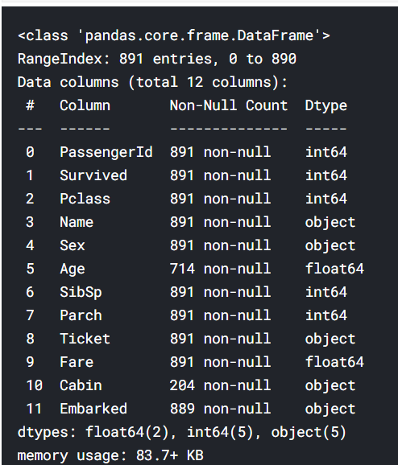
Data preprocessing
Problems in training data:
meaningless value
null value
non-numeric value

Slide 3
Drop meaningless value
Drop passenger ID and ticket number

Slide 4
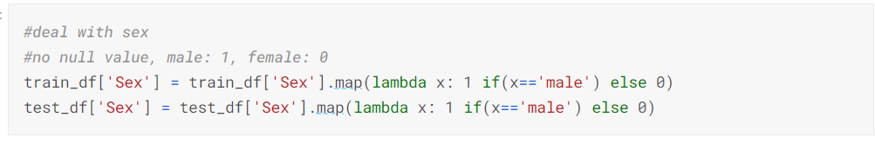
Sex
Transform “male” to 1 and “female” to 0

Slide 5
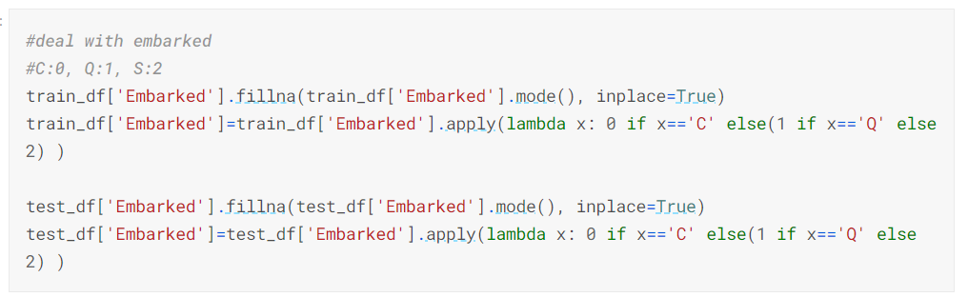
Embarked
Transform “C” to 0, “Q” to 1, “S” to 2
Fill NA with the mode of the data

Slide 6
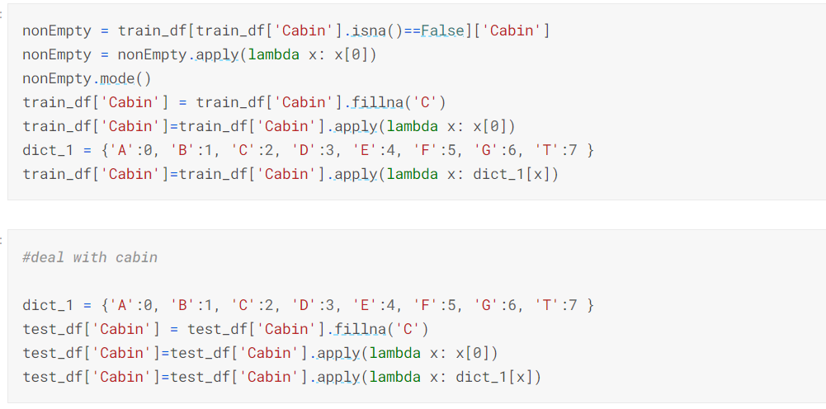
Cabin
Extract the letter of the cabin number to transform to numbers
FillNA with mode

Slide 7
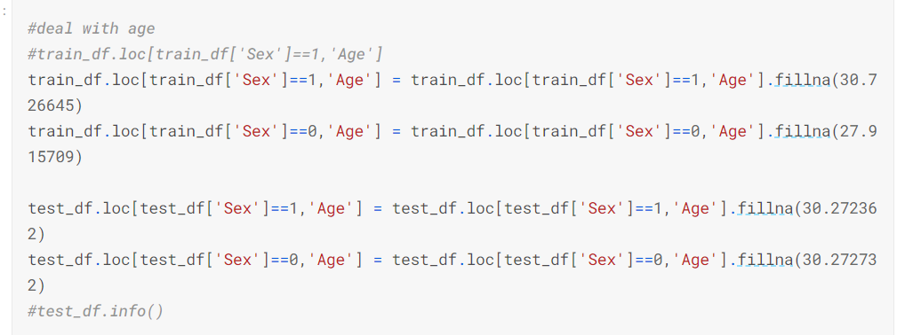
Age
FillNA with the mean age of male passengers and female passengers

Slide 8
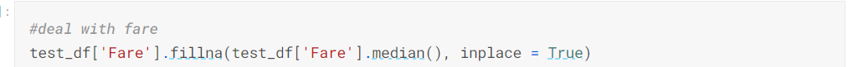
Fare
FillNA with the median of the fare

Slide 9
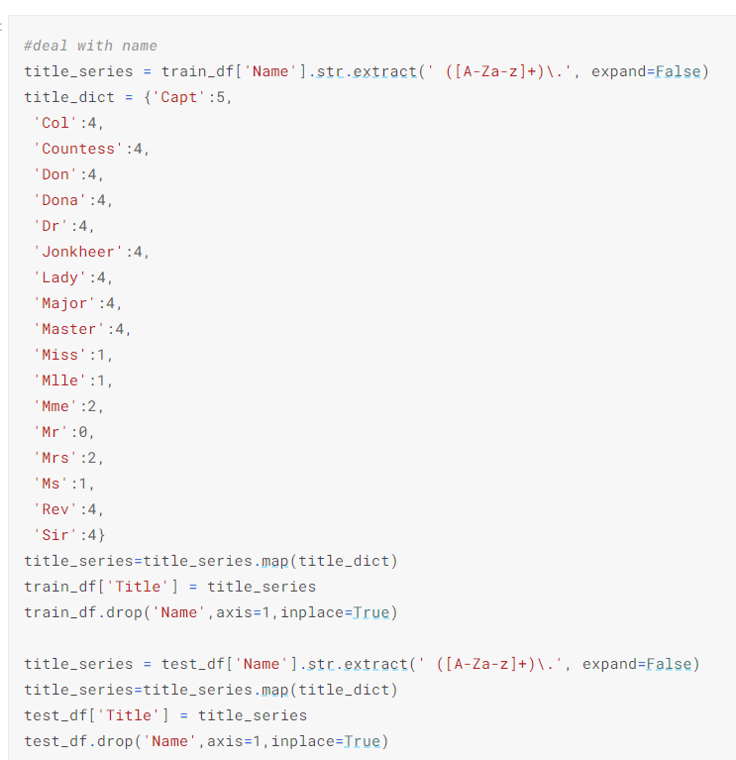
Name
Extract the title of the name
Transform the title to numbers

Slide 10
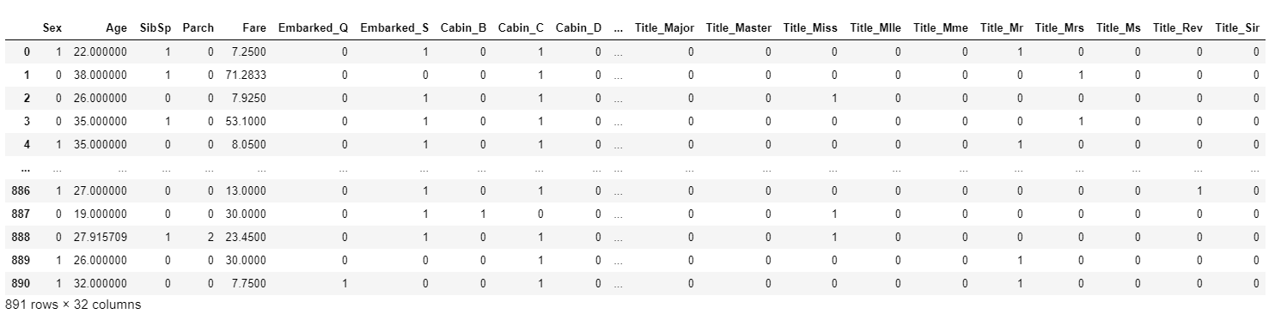
Training data with one hot encoding

Slide 11
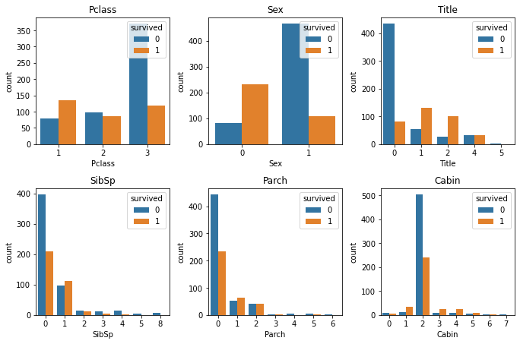
Training data distribution

Slide 12
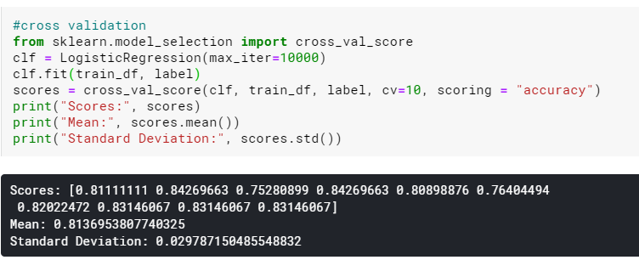
Logistic regression - without ohe
10-fold cross validation
average score is 0.81

Slide 13
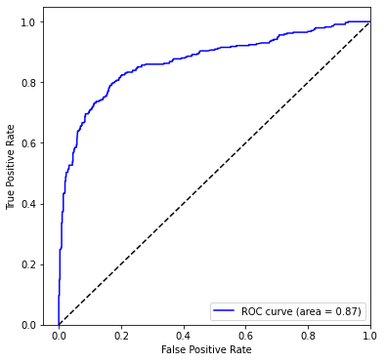
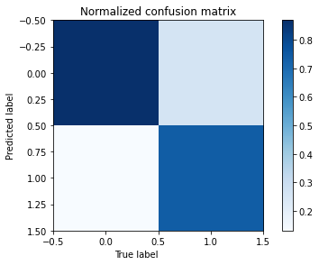
ROC curve and Confusion Matrix - without ohe
Notes:
false negative

Slide 14
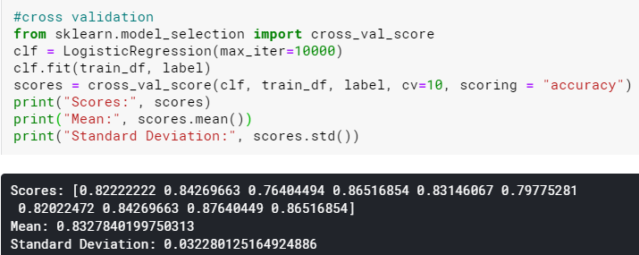
Logistic regression - with ohe
10-fold cross validation
average score is 0.83

Slide 15
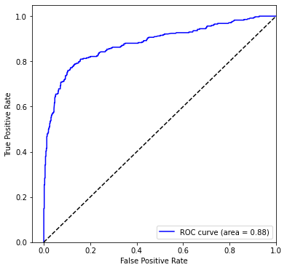
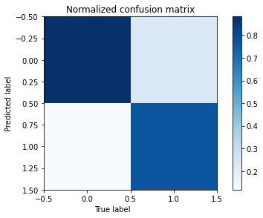
ROC curve and Confusion Matrix - with ohe

Slide 16
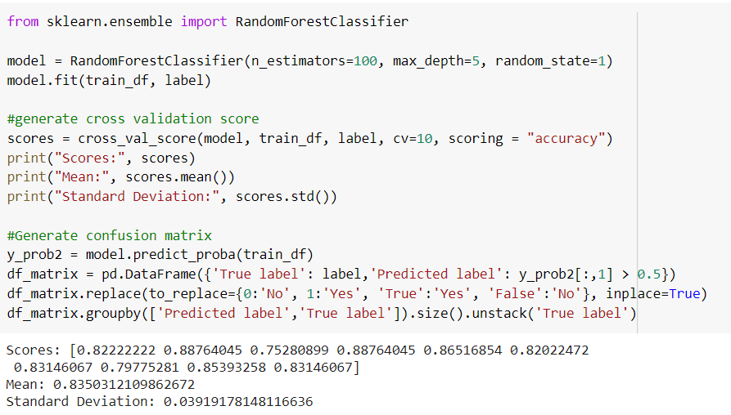
Random forest - without ohe
10-fold cross validation
average score is 0.84

Slide 17
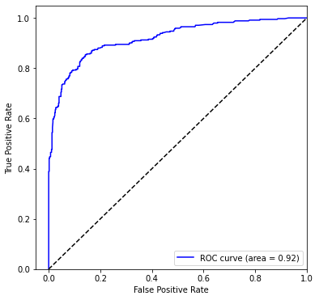
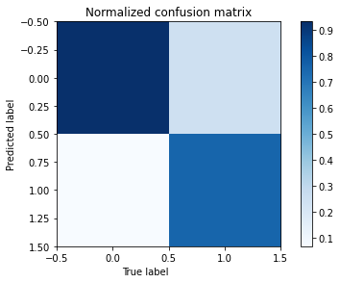
ROC curve and Confusion Matrix - without ohe

Slide 18
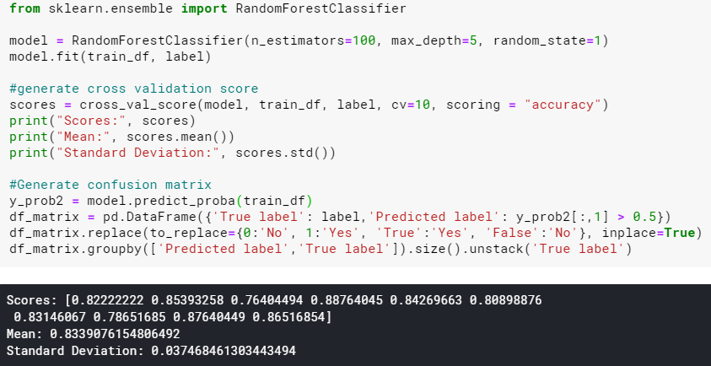
Random forest - with ohe
10-fold cross validation
average score is 0.83

Slide 19
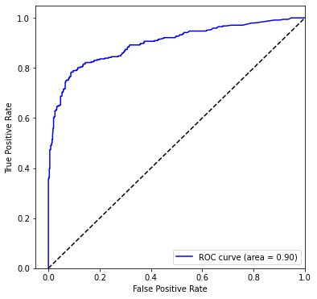

Random forest - with ohe

Slide 20
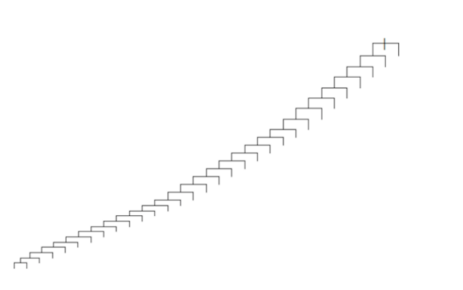
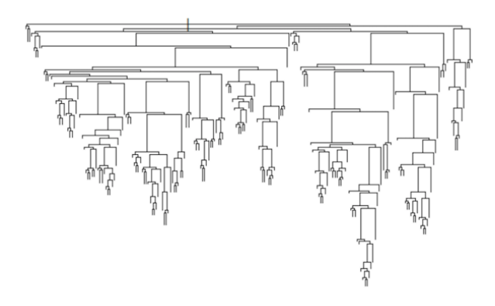
why ohe cannot use at random forest
Categorical variables have only a few options for splitting which results in very sparse decision trees. The tree grows in the direction of zeroes in the dummy variables.

Slide 21
Analysis
One-hot encoding make Logistic regression model perform better, but make random forest perform worse
Logistic regression performs slightly worse than random forest
linearity of the features is not strong
not continuous values
Logistic Regression cannot handle missing values require more data pre-processing
Overfitting occur in both model as the training set accuracy score is higher than the Kaggle score.

Slide 22
Conclusion
Random forest model is better for this Titanic survival problem.
minimal need to pre-process the data
handle missing values

Slide 23


MATH 4995 Mini-Project 1: Predict Survival on the Titanic
Ngai Nok Yiu (20510180), Cheung Hang Yee (20514796)
1. Introduction
3. Logistic Regression
5. Analysis
The Titanic survival problem is a binary classification problem. Given two type of features: passengers’ personal information(e.g. age,sex) and their trip information(e.g. Ticket number, Cabin number ), we need to predict whether they will survive the accident or not. We test two classification models - logistic regression and random forest classifier and compare their performance.
We fit the training data to a logistic regression model and perform 10-fold cross validation, the result average accuracy is 0.81, with sd 0.03. The ROC score is 0.87. The Kaggle score is 0.76794.
One reason why logistic regression performs slightly worse than random forest may be because the linearity of the features is not strong. Besides, most of the features are not continuous values which might not work well with logistic regression.
Logistic Regression cannot handle missing values unlike random forest which is immune to it as its underlyings are decision trees. So Logistic Regression require data pre-processing, which is not convenience.
Overfitting occur in both model as the training set accuracy score is higher than the Kaggle score.
Random Forest has a good Performance on imbalanced datasets than Logistic Regression.
Model:
2. Feature Engineering
To fit the logistic regression model, we need to encode the qualitative features to numeric one using mapping function. Although name of each passenger is not important, the title in the name reflect their social status which may affect the survival rate. We therefore extracted the title and build a new feature “Title”. We use the mean and median to fill the empty values in “Age” and “Fare”. We only keep the letter in “Cabin”.
6. Conclusion
Although the difference of two model are very small, We think random forest model is better for this Titanic survival problem. First, using Random Forest do not need to pre-process the data which saves time.
Second, Logistic Regression cannot handle missing values, which is not suitable for Titanic survival problem. Some of the data in Titanic survival problem are missing and we use mean, mode and median to replace them when using Logistic Regression. It will affect the accuracy and may not be general enough for new data.
ROC curve
Confusion Matrix
4. Random Forest
We fit the data to a random Forest: model and test it with 100 n_estimators. The average accuracy is 0.84, with sd 0.03. The ROC score is 0.92. The Kaggle score is 0.78947.
7. Contribution
Logistic Regression: Ngai Nok Yiu
Random Forest: Cheung Hang Yee
Count Plot of features
Notes:
In summary, we found that when increasing the variance in the explanatory and noise variables, logistic regression consistently performed with a higher overall accuracy as compared to random forest. However, the true positive rate for random forest was higher than logistic regression and yielded a higher false positive rate for dataset with increasing noise variables. In all simulated case studies, we consistently found that the false positive rate for random forest with 100 trees was statistically different than logistic regression. In general, logistic regression performs better when the number of noise variables is less than or equal to the number of explanatory variables and random forest has a higher true and false positive rate as the number of explanatory variables increases in a dataset. Logistic regression and random forest are comparable for smaller datasets with less than 1000 observations.

